Slide 1
Predicting Supply Chain Product Backorders
By Heather DeSimone

Slide 2
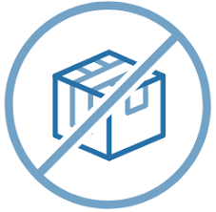
Problem Overview
Major supply constraints throughout the market
Labor shortage
Lack of raw materials
Clogged ports
Factory shut-downs
Backorders causing decline in revenue
Insufficient supply to meet demand
Overstock at warehouses once product arrives
Mitigating losses
Predicting backorders ahead of time can help in planning and forecasting

Slide 3
Approach
Through machine learning, we can build a predictive model that will use historical data from other products that went on backorder, to predict if a future product will do the same.
K-NN classification model
22 predictor variables
Target variable: will the product go on backorder
Data split into training, validation and test set to avoid overfitting
Final model has >98% accuracy

Slide 4
Results
Top 3 products in terms of forecasted sales through model to predict future backorders
sku#3449673
9 month forecasted sales of $3,162,260
Prediction of no backorder
sku#3301406
9 month forecasted sales of $3,124,704
Prediction of no backorder
sku#3337435
9 month forecasted sales of $1,858,864
Prediction of no backorder
Normal buying practices should be conducted for these 3 skus based on current trends and forecasting

